Slide 1
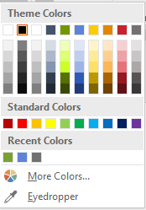
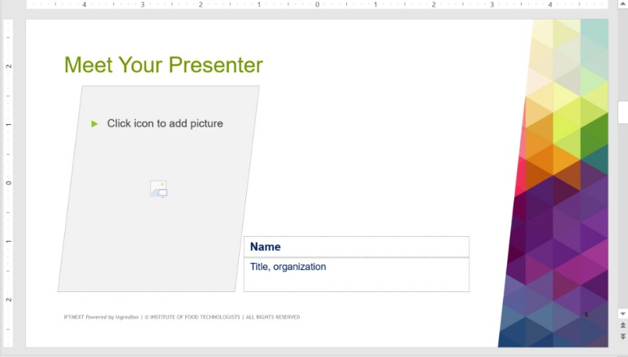
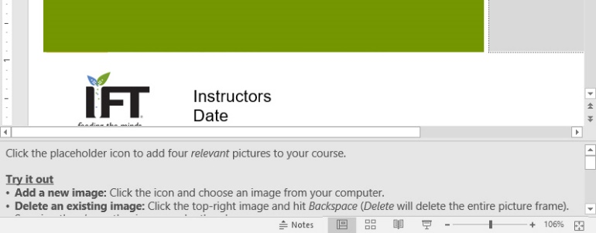
How to get started with this template!
1
Add a ‘New Slide’, apply a layout.
On the Home tab on the ribbon, select New Slide to see which layouts you have to choose from.
Tip | You can apply different layouts to existing slides by selecting the slide, then choosing Layout.
2
Edit the slides.
Use this template as your guide. Click on the components to edit directly and look for additional tips or steps in the Notes section.
Tip | Use the built-in color palette with green, blue, and orange for callouts and accents.

Slide 2
Base Layouts
To keep the stage presentations consistent, please use [at least] the following layouts:
Title Slide
Bio Slide (3 options)
Closing Slide

Slide 4
Notes:
Adding video helps your session pop! WIFI may not be reliable on the stage, so you should NOT link to a streaming site, like YouTube. Stick with Screen Recordings or videos you have the rights to use them.
Related Help:
Record your screen in PowerPoint: https://support.office.com/en-us/article/Record-your-screen-in-PowerPoint-0b4c3f65-534c-4cf1-9c59-402b6e9d79d0
Insert or link to a video on YouTube (not recommended): https://support.office.com/en-us/article/insert-or-link-to-a-video-on-youtube-8340ec69-4cee-4fe1-ab96-4849154bc6db

Slide 5
“If you want someone to remember your message – in a presentation, an article, or a report– tell them a story.”
—Rachel Gillett, Fast Company
Notes:
You can use color and formatting to drive a phrase or concept home.

Slide 6
Meet Your Presenter
Notes:
Click the placeholder icon to add four relevant pictures to your course. We have provided an image library at the end of this presentation.
Try it out
Add a new image: Click the icon and choose an image from your computer or select one from the collection at the end of this presentation and insert it.
Delete an existing image: Click the top-right image and hit Backspace (Delete will delete the entire picture frame). Surprise, there’s another image under there!
Modify an existing image: Right-click the bottom-right image and choose Change Picture or [even better] Crop. You can now move the image within the square, make it larger (hold down shift when you drag to maintain proportions), or only show a specific part of the image.
Related help
Adding images (overview): https://www.gcflearnfree.org/powerpoint2010/inserting-images/1/
How to add and edit online images to PPT: https://www.youtube.com/watch?v=X4BJU7dUw8c
PPT Support: https://support.office.com/en-us/article/Pictures-charts-and-tables-42b7df04-002d-48a8-9262-ad2f9ab408cd?ui=en-US&rs=en-US&ad=US

Slide 7
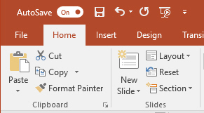
Adding Content Slides
There are a variety of layouts you can use for your content slides.
Choose New Slide^{v} to see pre-set layout options or create your own.
Remember to utilize white space to avoid crowding and visual overload.
Notes:
Try it out
Add a new slide: Choosing the New Slide icon will automatically add a basic title and body text layout.
Add a new slide from a preset layout: Choosing New Slide [text with the downward arrow] gives you a drop-down of presets.
Modify an existing slide: Choose Layout to apply a preset to an existing slide.
Related help
Apply or change slide layouts: https://support.office.com/en-us/article/Apply-or-change-a-slide-layout-158e6dba-e53e-479b-a6fc-caab72609689

Slide 8
Prepare
Build your story first, then define which layouts and graphics will best help visualize each slide’s message.
“How much text should I use?”
Less is more!
Use the Notes section to help you with your talking points and avoid reading your presentation slides!
“But this is important to know!”
Avoid including sentences that will already be used when talking.
“More words, less sentences”
Focus on action words that will enhance the viewer experience.
Notes:
This layout is great to set up a case study or articulate a point. You can use text to drive content home or insert images to illustrate a process.
Fonts used in columns:
Headers: Arial, 18 point, bold, Theme Color: Dark blue, [Line Spacing] Space after: 24pt
Body: Arial, 14 point, black

Slide 9
Use Transitions & Section Dividers
Consistency helps the viewer see connections in the story.
Tip | Using the same layout and transitions throughout your presentation gives your audience a mental check-point and helps them stay focused.
Notes:
The following slides show the full suite of page layouts.

Slide 10
Presenting
Speak loudly and clearly.
Be aware of your pace and stick to the time scheduled. You don’t want to cut into the next instructor’s program.
Engage the audience with eye contact, move about the room, and try getting feedback from all learners.
Leave time at the end of each day to summarize what was covered and answer questions.
Have fun!

Slide 11
Checking Content
Writing and content flow
Grammar
Capitalization and punctuation
Clear, concise, consistent, and descriptive
Data fact-checked
References cited
Editing Slides
Clear and concise headings
Consistent fonts
Bullet points
Multimedia to convey meaning

Slide 12
QUESTIONS or Ending Quote?
Notes:
Enter a placeholder for questions at the end of your presentation OR think of a thoughtful or relevant question you can pose to audience members to help make your presentation memorable.

Slide 13
List key, applicable takeaways for your audience here.
Alternatively, you can engage learners at the end of your presentation with a thoughtful prompt, question, or engaging activity.
How will you apply these concepts?
How will this help you __?
Why does __ matter?

Slide 14
Notes:
End your presentation with this slide.

